Slide 1

InsuranceSuite 10 Fundamentals
Implementation Practices for Digital

Slide 2
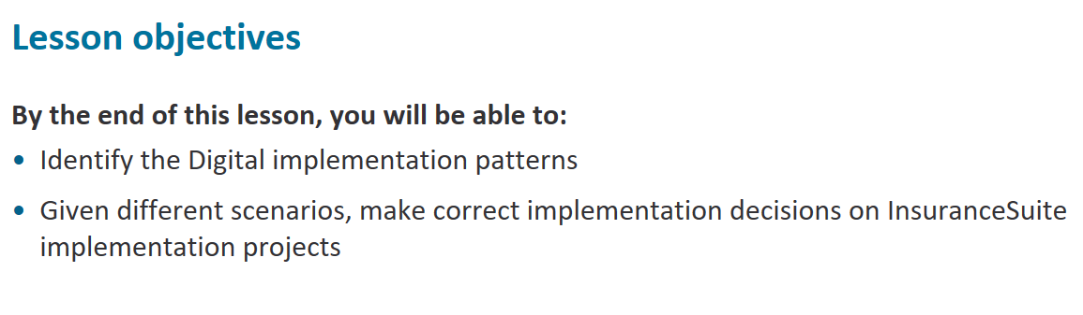

Slide 3
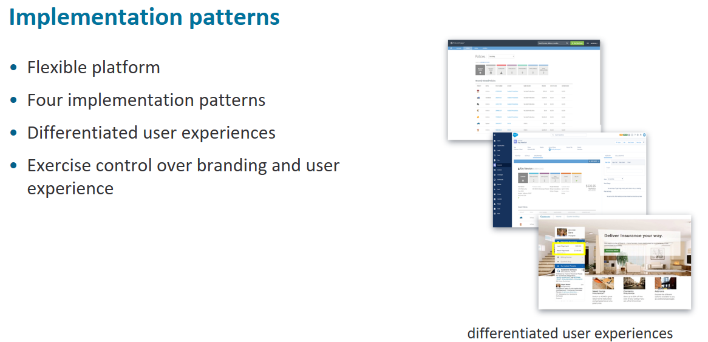
Notes:
The digital applications are built to provide you with the flexibility to vary the user experience as much as you want. The best choice will ultimately depend on your digital strategy and how much time and effort you can invest There are four common patterns for creating differentiated user experiences with Guidewire Digital products. Choosing an implementation pattern depends on business drivers and each pattern has an associated cost and complexity All patterns are fluid and will offer the ability to retain brand and control over the user experience.
Next, you will learn how each of the four patterns utilize the Digital architecture differently.

Slide 4
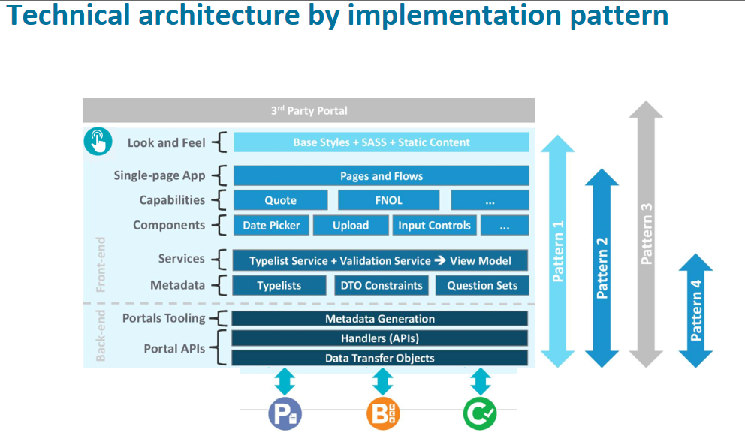
Notes:
As a reference, here is a chart of the technical architecture by implementation pattern. All patterns leverage back-end services and tooling, but use front-end services to a greater or lesser extent.

Slide 5
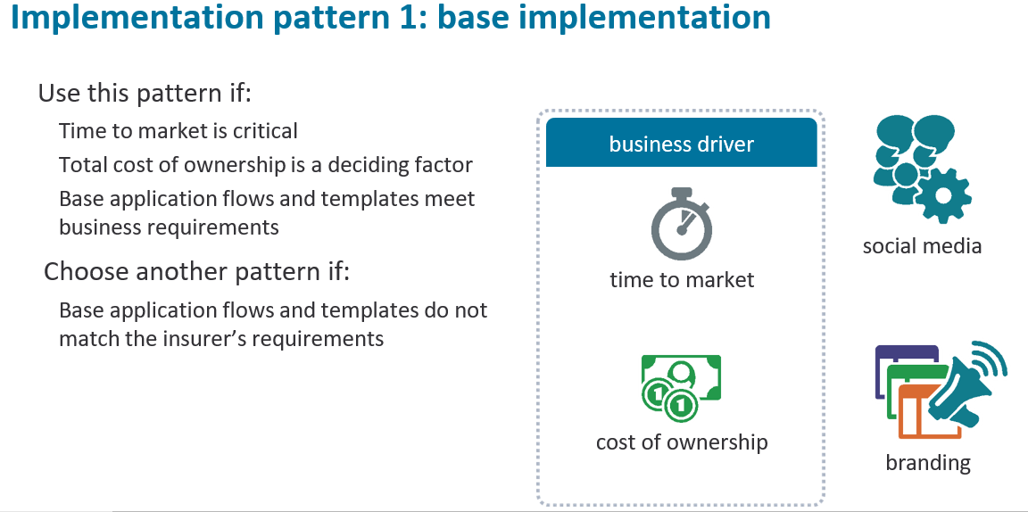
Notes:
If time to market and long term total-cost of ownership is the key business driver, insurers can leverage out-of-the-box branding features of the product, changing style
sheets, fonts and images to change the look and feel of the pages. Besides changing style sheets and backgrounds, external content such as social media hooks to
display Facebook, Twitter, or YouTube videos, or even plug-ins to display related information like telematics dashboards can be configured.
For example, on the Producer Engage desktop, you can add a section of the screen designed to add your own content like product or UW appetite guidelines, product marketing or event promotion like agent conferences or social media hooks like Facebook or Twitter feeds. A similar configurable marketing sidebar is available for policyholders via the Customer Engage application.

Slide 6
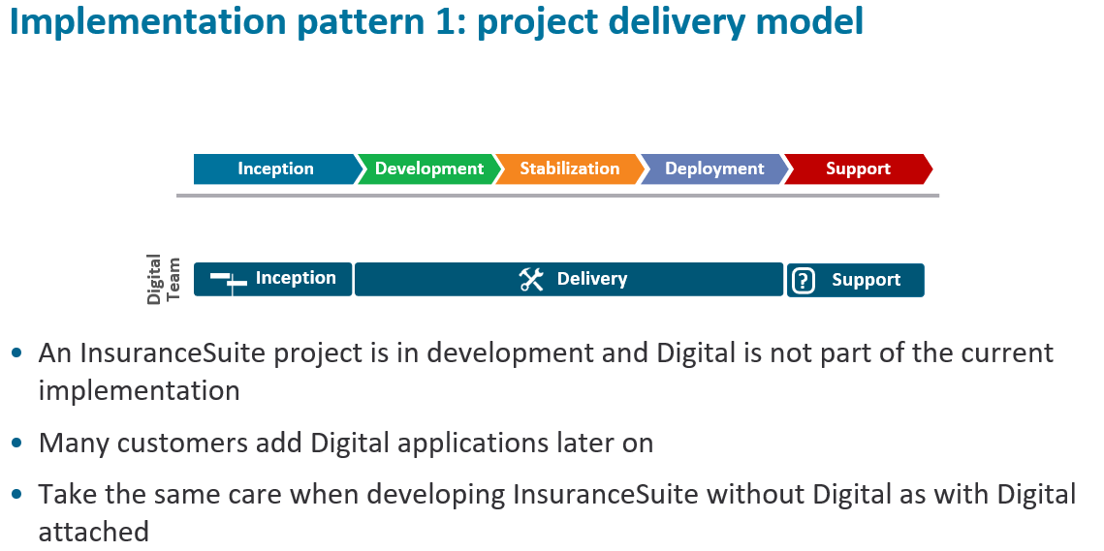
Notes:
In many cases our pattern 1 customers add Digital applications later on after an InsuranceSuite implementation has completed. The Digital implementation team will
work alongside InsuranceSuite teams on pattern 1 implementations.

Slide 7
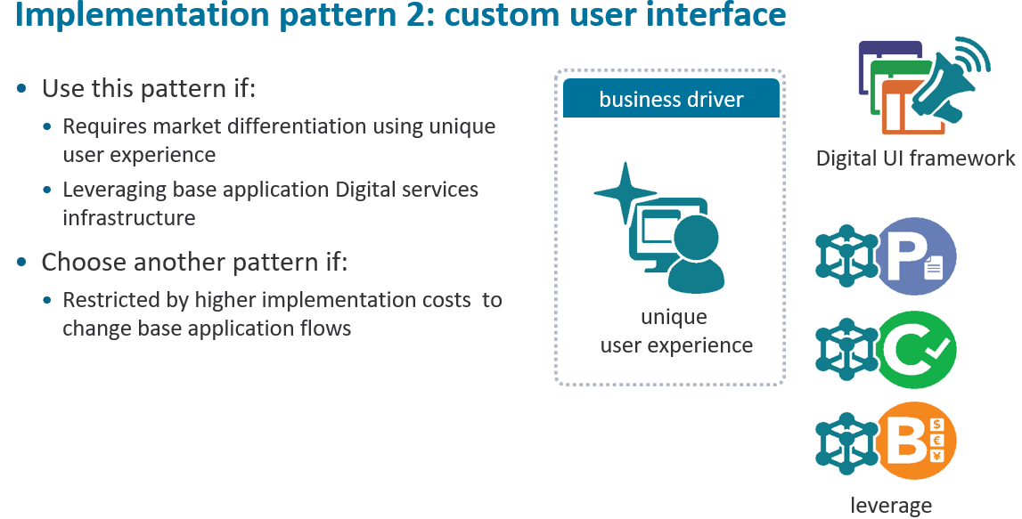
Notes:
Instead of just “tweaking” the base application user interface, some insurers have chosen to completely replace the visual aspect of the portals with their own custom design while still leveraging the frontend framework (UX Control layer) that comes with the Guidewire Digital Applications. A customer could use an outside design firm to design a custom ‘User Journey’ and set of pages consistent with their brand and then build those pages using the Digital framework so be able to leverage the optimized reuse of
customer core system configurations and integrations, while being able to implement the UI and UX exactly as specified by the design.
Insurers can expect higher implementation costs than pattern 1 due to changes in OOTB flows and design of the carrier template. However, if the carrier already has existing page designs ,these can be leveraged to bring down costs.
This is probably the most commonly- used pattern with digital implementations and it strikes a balance between leveraging out-of –the box capabilities and custom user experience design.

Slide 8
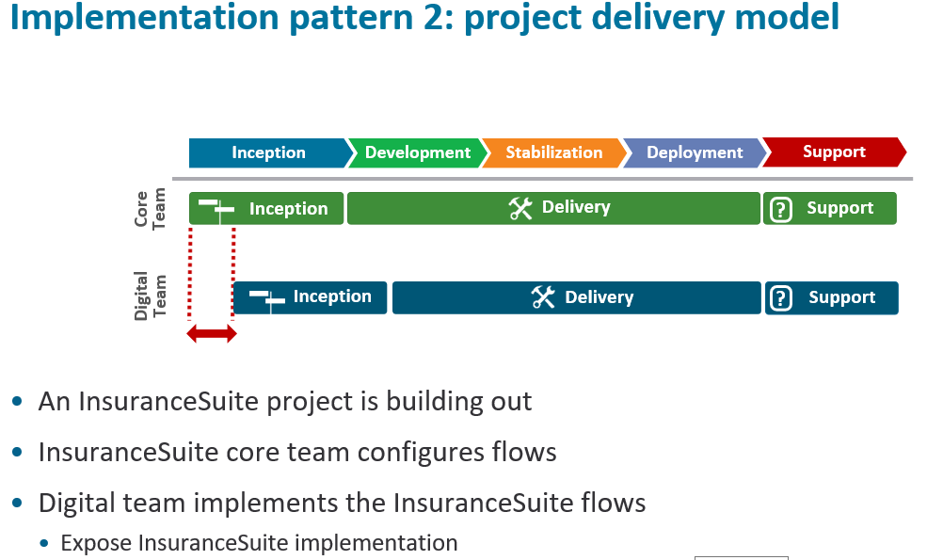
Notes:
For pattern 2 projects, the customer is building out InsuranceSuite and lets the InsuranceSuite core team configure the flows. The Digital team then implements the flows, exposing what has already been defined in InsuranceSuite. Much of this work will involve reverseengineering InsuranceSuite flows and forms in Digital.
Pattern 2 projects require a lag time between the InsuranceSuite inception/delivery and the Digital inception/delivery.

Slide 9
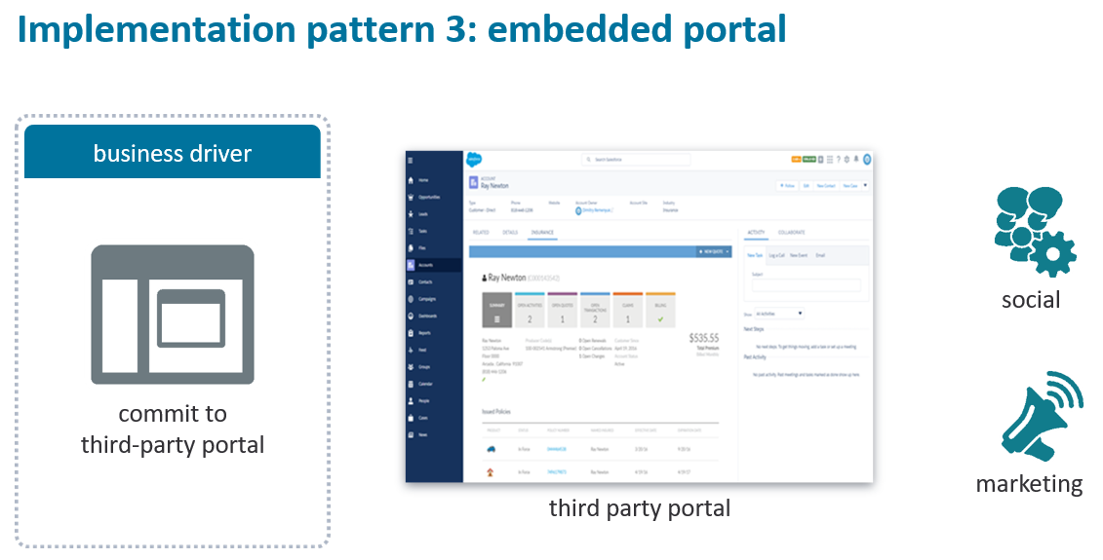
Notes:
For customers who have already committed to a horizontal third party portal like Liferay, Salesforce or Backbase for example, you can still integrate Guidewire Digital
products with these platforms.
Implementations built using patterns 1 and 2 can be embedded within a 3 party portal. This approach leverages the general capabilities of third party portals such as chat,
marketing content tools, and lead management, while also utilizing the transactional access to InsuranceSuite using Guidewire Digital services.

Slide 10
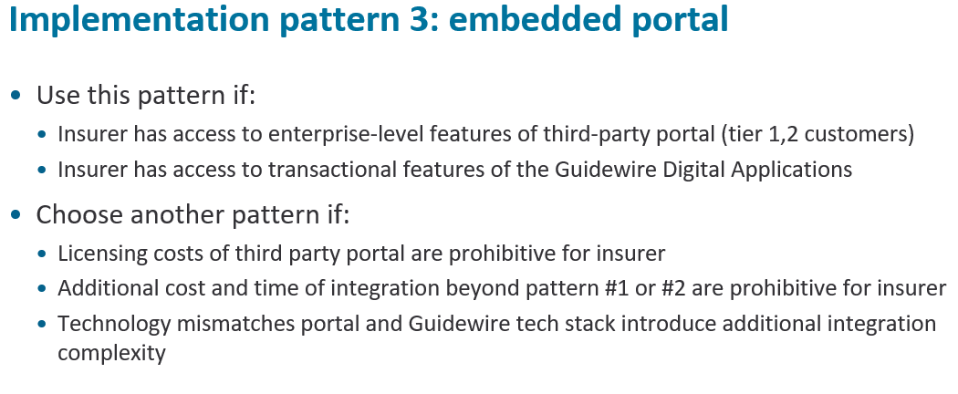
Notes:
This pattern would also potentially work with most internally developed portals, depending on the technologies used. Use this pattern if:
• Insurer has ready access to the enterprise-level features of the third party portal, as well as the transactional features of the Guidewire Digital Applications
Because pattern 3 uses full pages and flows, you still get the benefit of Pattern 1 or 2 type styling, which can of course be tailored to match seamlessly with the 3rd party portal
Choose another pattern if:
• Potential higher costs/additional licenses of 3rd party portal restrict this pattern (primarily,tier1 insurers will go for this)
• Additional Implementation cost and time beyond Pattern#1 and pattern#2 required for customer integration with the third party portal out of scope for insurer
• Potential technology mismatches between homegrown or third-party portal and Guidewire tech stack introduce complexity to integration effort

Slide 11
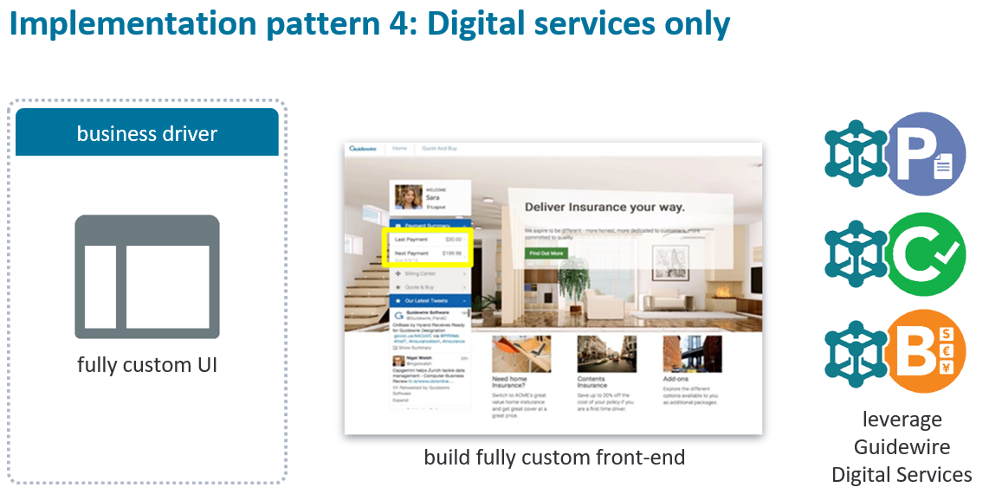
Notes:
Finally, for insurers who want to invest extra effort and are committed to a completely different user interface framework. With pattern four you can create an entirely custom front end from scratch, still leveraging the Digital services and foundational front end services to provide significant lift for your implementation.
Guidewire provides frontend/ client-side services such as a validation service to more easily leverage validation rules defined in the Guidewire core systems and a rich backend API that can be leveraged to build a custom portal.

Slide 12
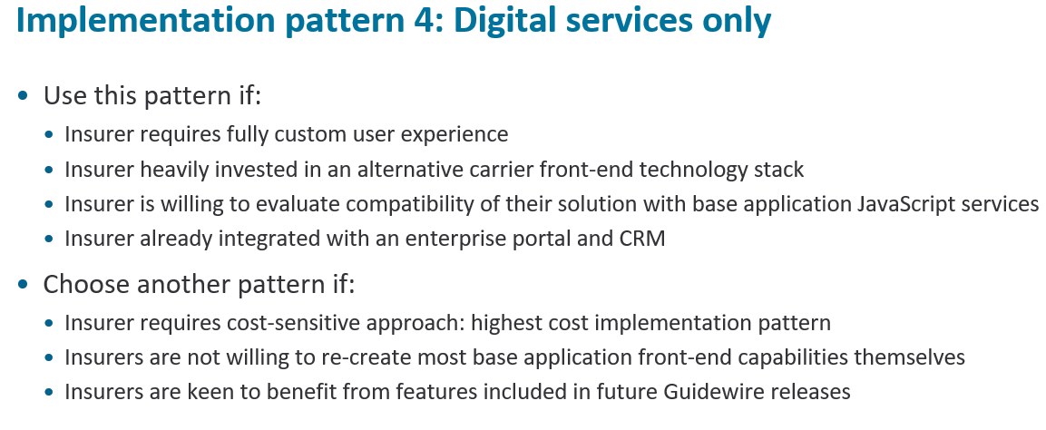
Notes:
Use this pattern if:
• Insurer willing to invest in fully custom user experience
• Insurer is leveraging any existing carrier frontend technology stack
• Insurer may already be integrated with an enterprise portal and CRM
Choose another pattern if:
• Significantly higher cost of implementation compared to any of the previous options.
Carriers who go down this path will need to re-create most of the capabilities already provided OOTB by the Guidewire frontend.
• Depending on the technology of the custom portal, the OOTB java script services on the front end may or may not be available for use with the custom portal
• Guidewire continues to dd additional capabilities on the front end with each release . The carrier will not benefit from these new features when using pattern#4.

Slide 13
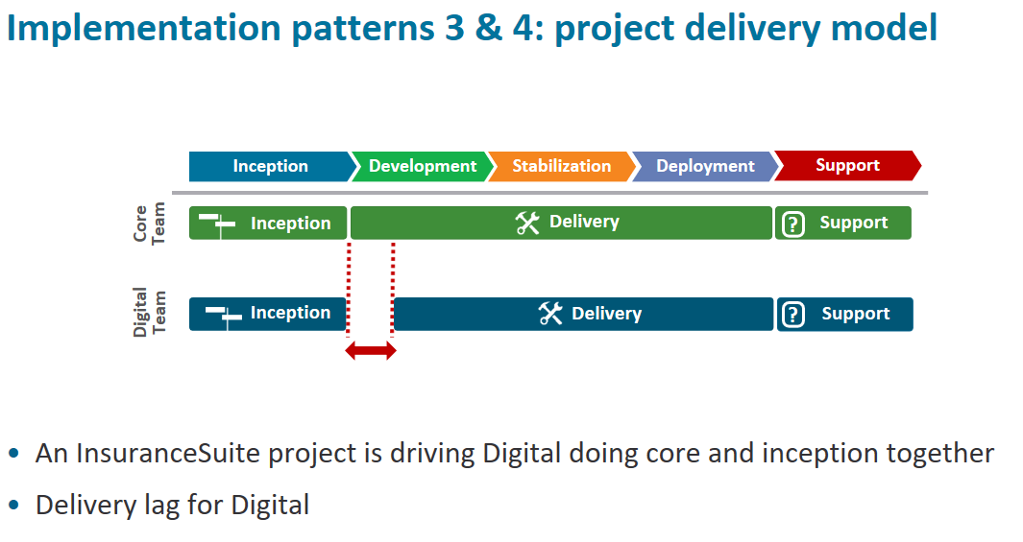
Notes:
For implementation patterns 3 & 4, the InsuranceSuite implementation is driving the agenda for Digital teams by doing core and inception together. Expect that these
projects will have a lag between InsuranceSuite development and Digital development as the Digital teams will have to implement the InsuranceSuite flows, exposing what has already been defined in InsuranceSuite.

Slide 14
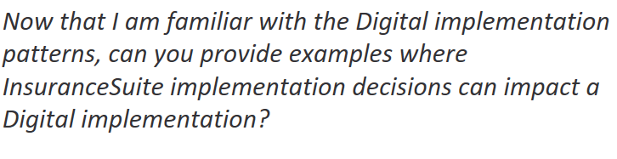

Slide 15
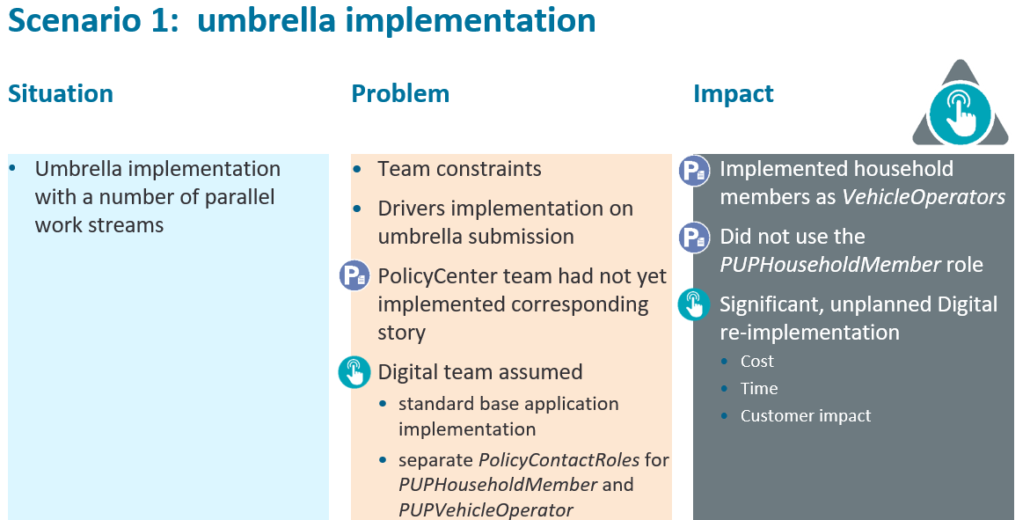
Notes:
Situation
• Umbrella implementation with a number of parallel work streams
Why was it a problem
• Team was under lots of pressure at the time to complete user stories, and one of the stories was regarding the implementation of Drivers on the Umbrella submission.
• Unfortunately, the PolicyCenter team had not yet implemented their corresponding story.
• The digital developer reasonably assumed that the PC implementation would follow the standard out of the box implementation which has separate PolicyContactRoles for PUPHouseholdMember and PUPVehicleOperator
What was the impact(extra work incurred by digital team)
• PolicyCenter team implemented household members as VehicleOperators and are not using the HouseholdMember Role.
• Digital team had to spend significant time reimplanting the portal changes to build the dto models.

Slide 16
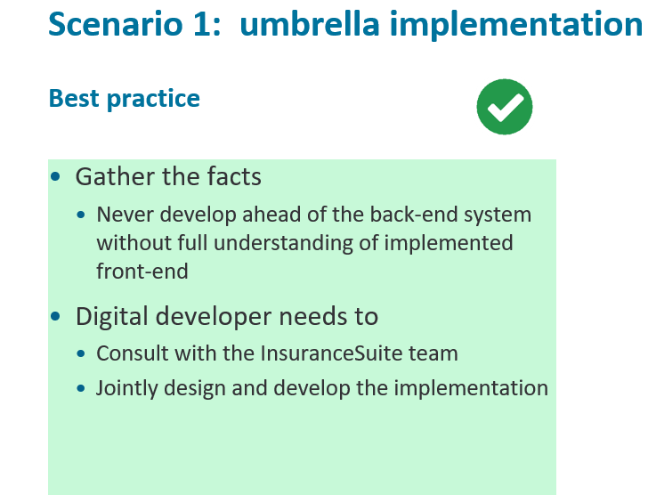
Notes:
How can it be prevented?
• Lesson learned: don’t develop ahead of the backend system without full understanding of what is to be implemented on the front end.
• If the Digital developer who worked on this had at least consulted with the PC developers, they could have jointly designed and developed the implementation and
avoided the issues they later faced.

Slide 17
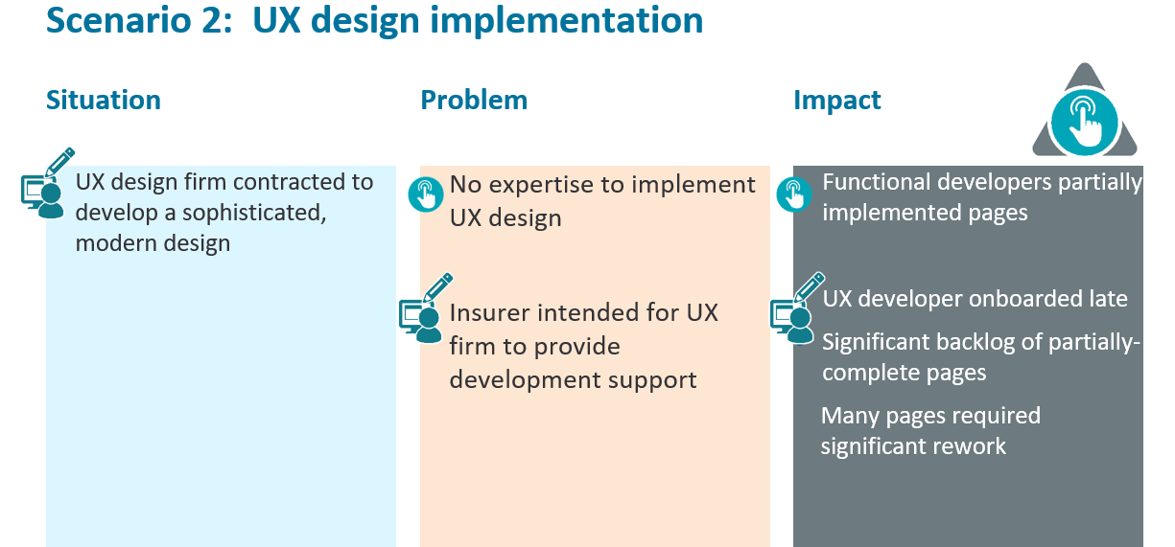
Notes:
Situation
• Customer contracted with a UX Design firm to develop a very nice, modern design.
Why was it a problem
• The development team did not have the expertise to implement that design.
• Their intent was to contract with the UX Design firm to have a developer from the design firm help with the implementation.
What was the impact(what extra work had digital team to do ?)
• Functional developers were instructed to partially implement the page designs with the understanding that the contractor would follow to fine tune the UI
• The Contractor was very late in joining the project
• Left a significant backlog of partially implemented UI Pages
• Many of those pages had to be significantly reworked

Slide 18
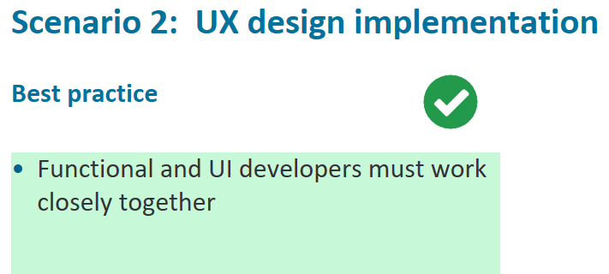
Notes:
How can it be prevented?
• The functional and UI developers should work together

Slide 19
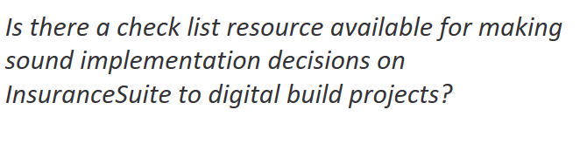

Slide 21
